Slide 1

Section 5 Project
United Kingdom 2019 General Election

Slide 2
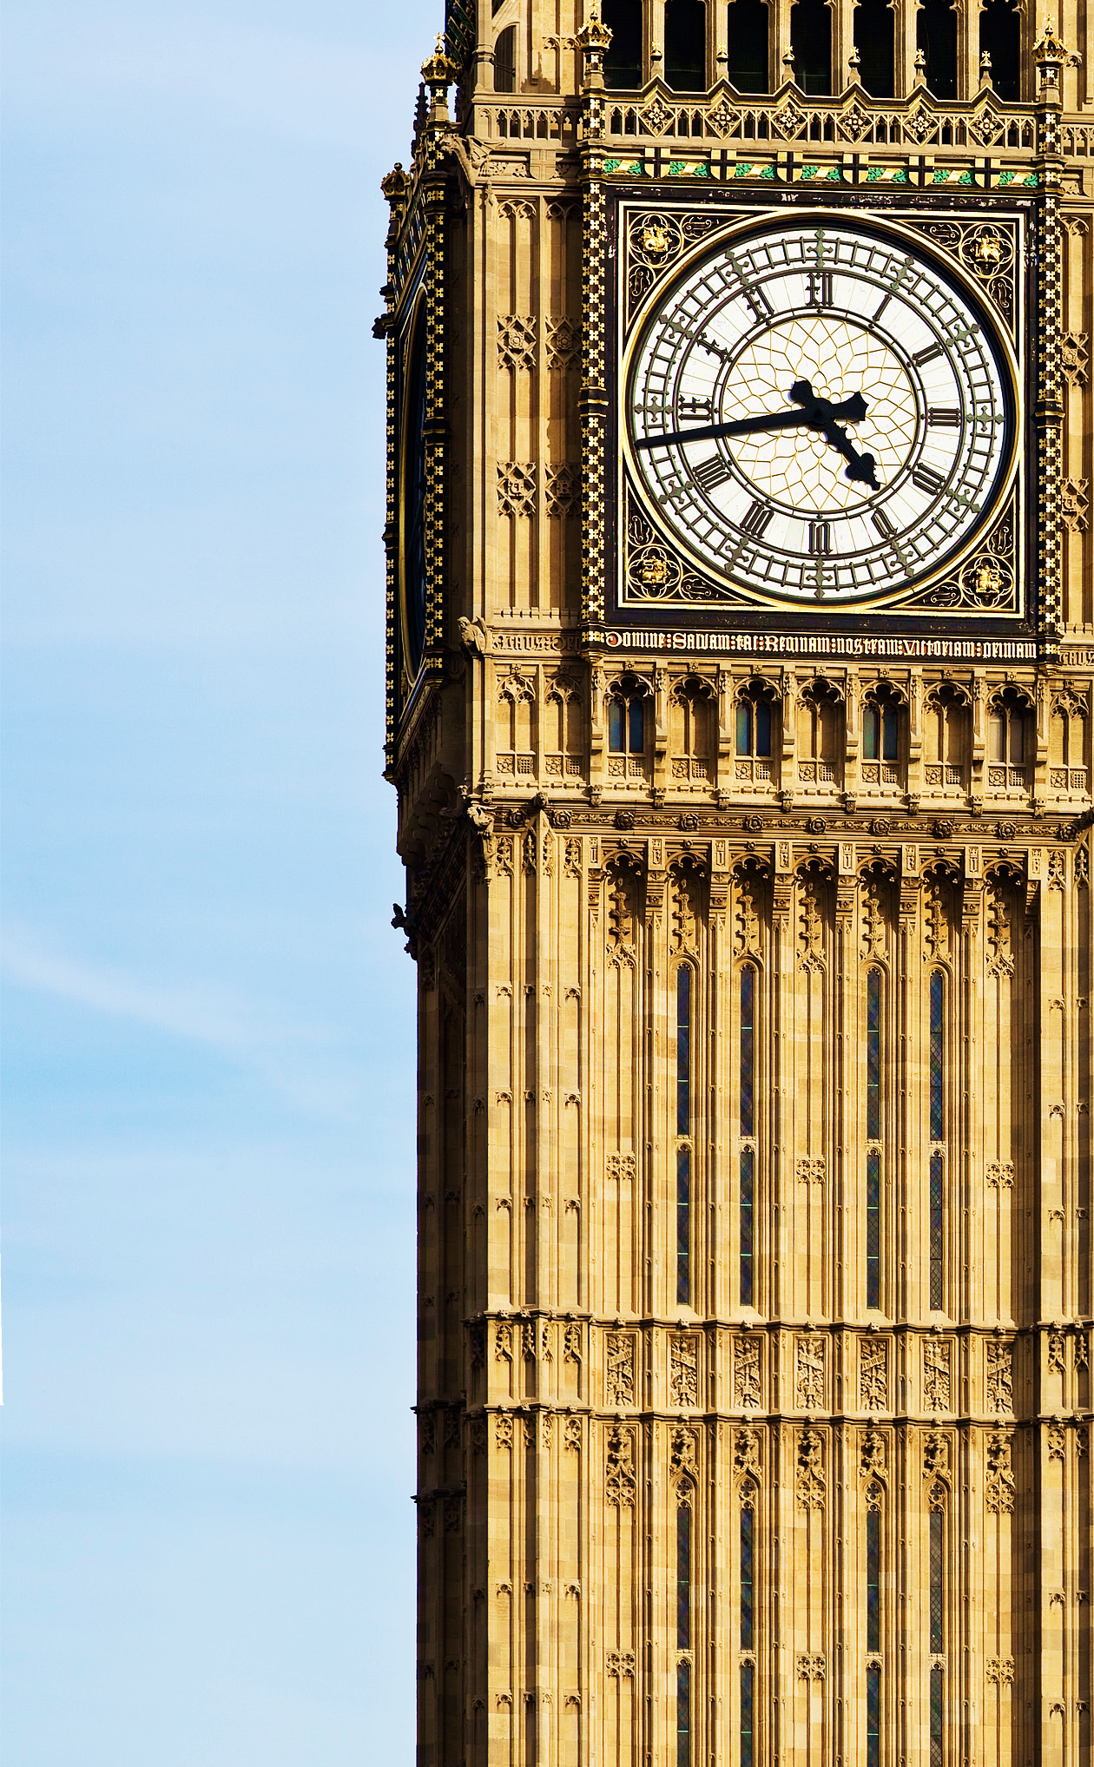
Executive summary
A brief introduction to UK Politics
The case for data science
Clustering analysis
Predictive modelling
Possible next steps
Appendix contains additional analysis

Slide 3
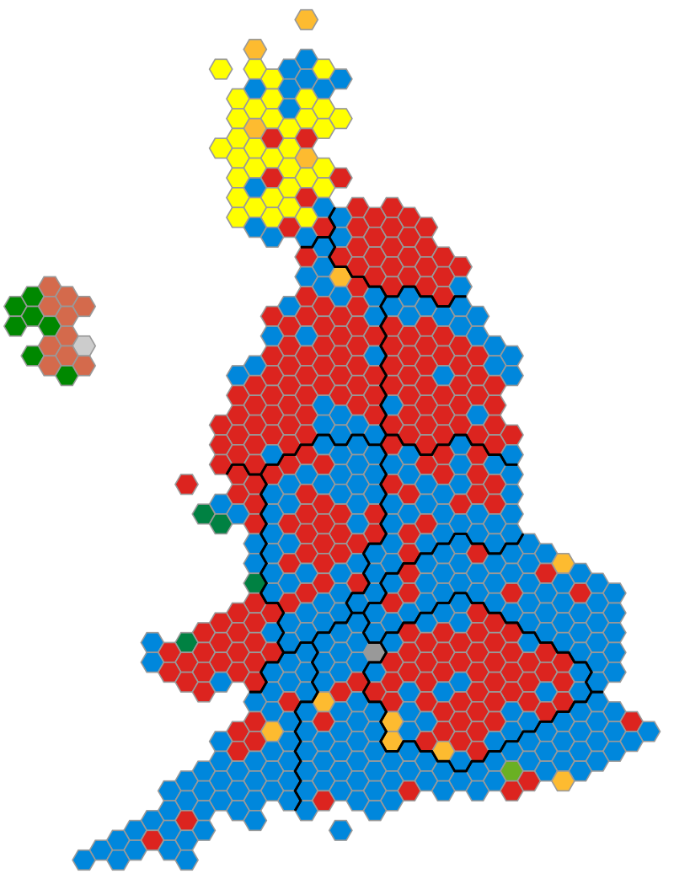
UK Politics – General Elections
Conservative
Labour
Political power in the UK lies in the House of Commons
650 MPs attend parliament – one from each of the UK’s 650 ‘constituencies’
In a General Election, each constituency votes for a single MP from a selection of candidates unique to that constituency
The one candidate that wins the most votes is elected
The political party that has the most elected MPs wins the election, and typically forms the government
The results of the 2017 General Election
SNP
Lib Dem
Plaid Cymru
Green
DUP
Sinn Fein

Slide 4







UK Politics –Parties
Authoritarian
The two main parties are the Conservatives and Labour. They have won every election since 1922*
Scotland and Wales have nationalist parties (SNP and Plaid Cymru respectively) that only stand in those nations
Northern Ireland has a different set of parties entirely. For this reason, NI is mostly excluded from our analysis
Economic
Left
Economic
Right
Libertarian

Slide 5


The case for data science
Though there is emphasis on the national campaign, UK General Elections are, in essence, 650 mini-elections
Voters in different parts of the country can have very different concerns. Local campaigns may need tailoring at a constituency level
Resources are tight – there are strict campaign spending limits (and a finite number of party activists to deploy)
Which data science techniques could be useful here?
Clustering
By clustering constituencies based on their characteristics, we can see if there are any seats that parties are underperforming in, allowing them to better target resources
Classification
By creating a classification algorithm that predicts how a constituency votes (based on a range of local KPIs) we can better understand what factors drive voters of the different parties

Slide 6
The data used in this analysis
Data is taken from official Government sources. It includes the following KPIs for each constituency:
Type of constituency (big city, small town, etc.)
Population / population density
Age demographics
Incorporated businesses (3 KPIs)
Unemployment rates (absolute and growth)
Median weekly wages
Share of jobs paying below local living wage*
House prices (absolute and growth)
House ownership status (4 categories)
Share of families with children owning own house*
Share of people working in given sector (12 categories)
Share of people in managerial or professional roles*
Share of people by qualification level (5 categories)
Share of people by ethnicity (4 categories)
Share of people by religion (7 categories)
Share of people by country of birth (11 categories)
Broadband quality in constituency
Change in Local Authority spending power*
Share of early-years childcare providers rated at least ‘Good’ by government inspectorate*
Social mobility KPIs for children in poverty (8 KPIs)*
Per-pupil school funding (absolute and growth)*
School quality metrics (4 KPIs)*
Share of people with chronic diseases (5 categories)*
Average number of chronic diseases per capita*
Share of people voting to leave the European Union

Slide 7
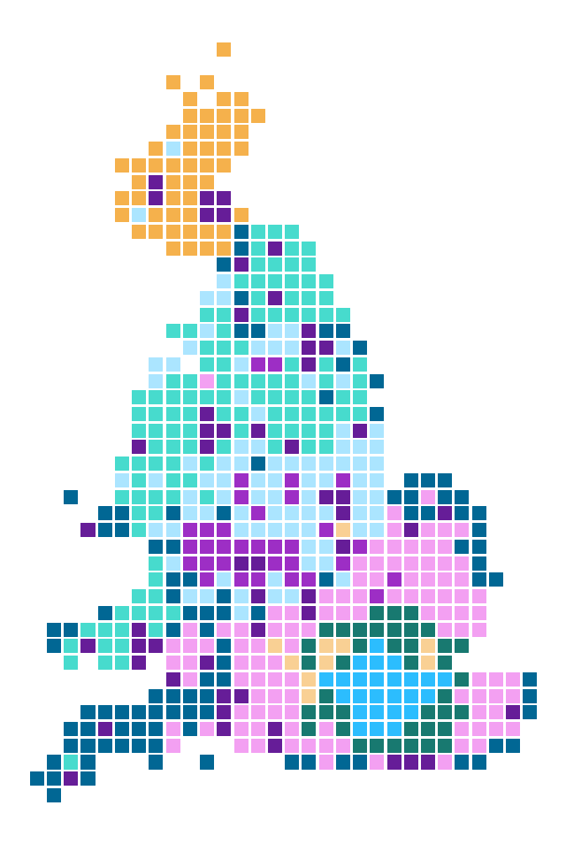
Clustering constituencies
Clustering analysis of UK constituencies, using HAC*
Conventional thinking might assume seats are similar based on shallow assumptions, e.g. how they voted historically
We can use a clustering algorithm to see which constituencies are demographically similar (and should hence vote similarly)
Any seats that vote anomalously compared to others in their clusters could therefore be targeted in election campaigns
Though some clusters are geographically concentrated (e.g. London and Scotland), this is not always the case – many seats in East Anglia look very similar to seats in the South East, North Wales, Cumbria, and the Kentish Coast

Slide 8
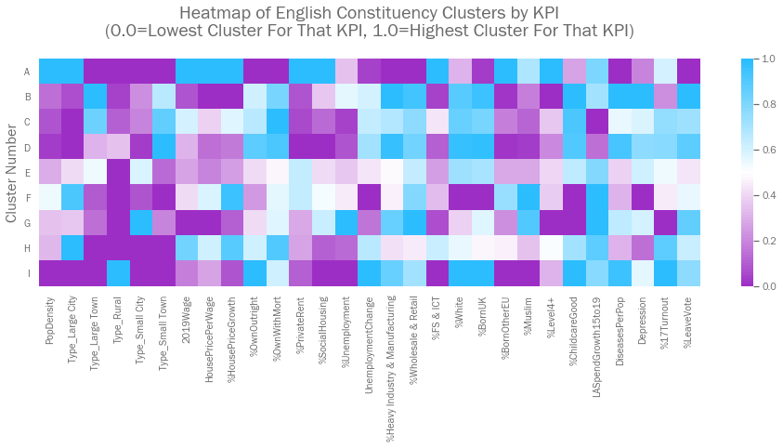
A use case for clustering – Sefton Central
English constituencies in Cluster D are overwhelmingly Conservative safe seats. They would therefore want to target the one Labour safe seat in that cluster (Sefton Central)
They could look at the average demographics of Cluster 3 to help further tailor messaging
Seats In Cluster By Type | A | B | C | D | E | F | G | H | I
Conservative Safe Seats |  | 47 | 67 | 96 | 3 |  | 2 | 11 | 30
Conservative / Labour Marginals | 3 | 55 | 11 | 23 | 11 | 4 | 14 | 9 | 1
Labour Safe Seats | 20 | 35 |  | 1 | 26 | 20 | 15 | 1
Conservative / Lib-Dem Marginals | 2 | 2 | 5 | 5 | 2 |  |  | 3 | 2
Lib-Dem Safe Seats |  |  |  |  | 2 |  |  | 2
Labour / Lib-Dem Marginals |  |  |  |  | 1
Green Safe Seats |  |  |  |  | 1
Cluster D Characteristics
Constituents have high rates of home ownership, with low levels of social housing
House price growth has been low
A high share of people work in Heavy Industry, and wages are below average
Most people are white and UK-born
Early-years childcare is decent, but education levels are generally low
Local authority funding has been cut heavily
There is a high rate of chronic illness
Many people voted to leave the EU

Slide 9
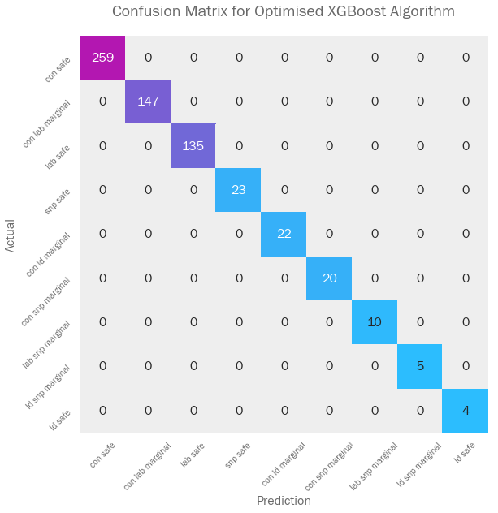
Categorising constituencies
CB91 has created a model that perfectly predicts a constituency’s voting preference
The model makes its predictions using the constituency demographic data (as seen in the clustering exercise)
We can use this model to further understand what drives the voting in each constituency

Slide 10
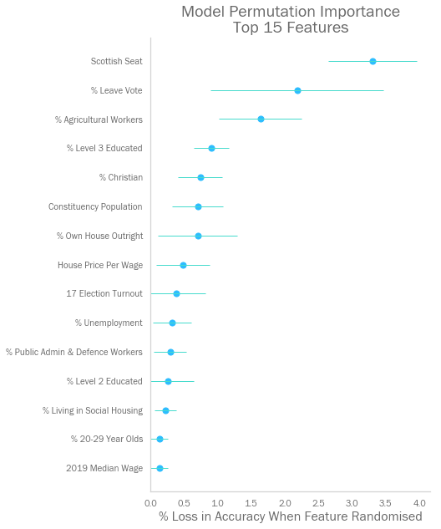
Explaining the model’s decisions
CB91 used ’Permutation Importance’ to see which factors had the biggest impact on the model:
For each feature in turn, shuffle the values for each constituency
Re-run the data through the model and see how much the model’s accuracy decreases
This procedure breaks the relationship between each feature and the seat type, thus the drop in accuracy is indicative of how much the model depends on that feature

Slide 11
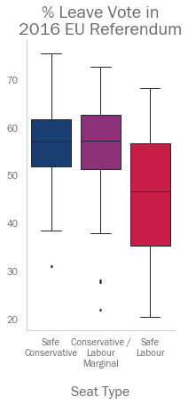
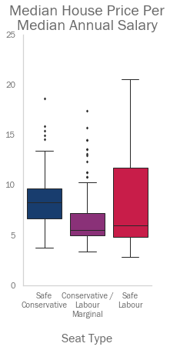
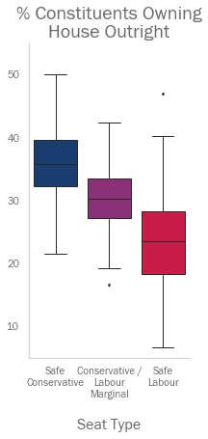
Analysing important features
The seats that Labour was competitive in cover a very wide range of values
Thus, a single policy position would have failed to appease all potential Labour voters simultaneously
The Labour / Conservative marginal seats look much more similar to safe Conservative seats than to safe Labour seats
Thus, the Conservatives were able to have more focussed policy, without the risk of alienating either its core base, or its potential voters in Labour marginals
Three of the most important features, as identified by the Permutation Importance exercise on the previous page

Slide 12
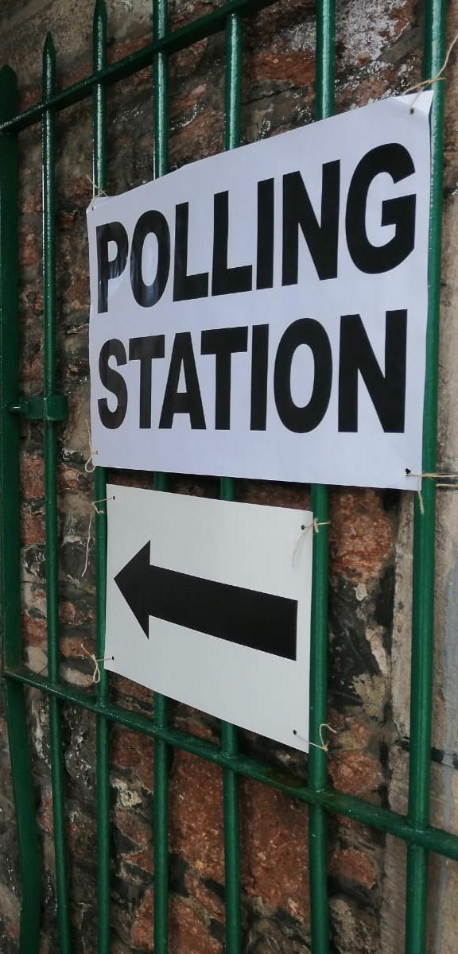
Possible next steps
There are further steps we could take to improve the analysis. We could:
Go into more detail across a full range of marginal constituencies
Investigate feature importance with other libraries, e.g. LIME
Re-run analysis against final results from 2019 general election
Improve the accuracy of the feature dataset following the 2021 census

Slide 13
Thank you for your time
Further detail on the model, and additional analysis of the dataset is included in further pages

Slide 14
Hierarchical agglomerated clustering – in more detail
HAC creates clusters by gradually joining datapoints that are ’close’ to each other. Closeness is defined by Euclidean distance, so all features are scaled (so that the natural magnitude of a feature doesn’t influence the clustering).
HAC starts by treating each datapoint a cluster. It then joins the two closest clusters (even if this cluster is simply a single datapoint).
It continues to join the next closest ‘clusters’ iteratively (measuring distances between the clusters’ centres) until you have only ‘n’ clusters remaining. This level of ‘n’ is set before the algorithm is run.
First 6 stages of an HAC algorithm
1
2
3
4
5
6

Slide 15
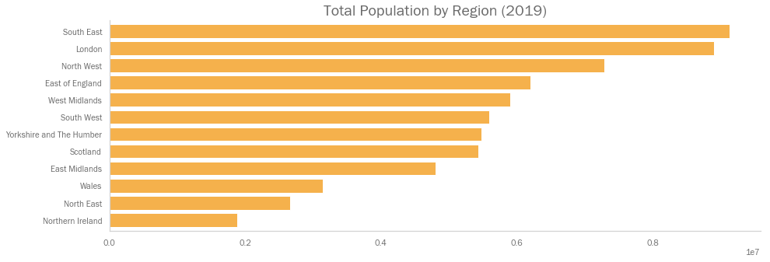
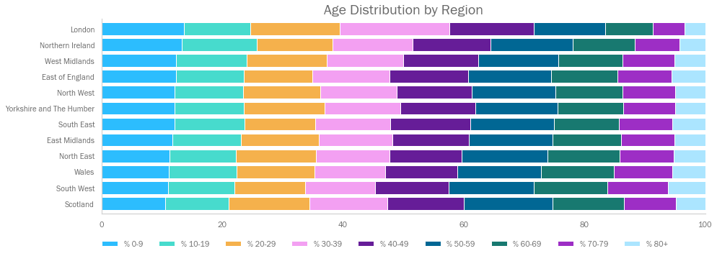
Population and age distribution by region
Additional Analysis

Slide 16
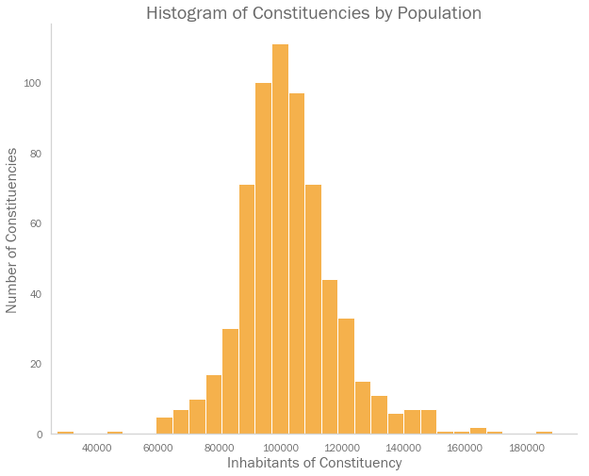
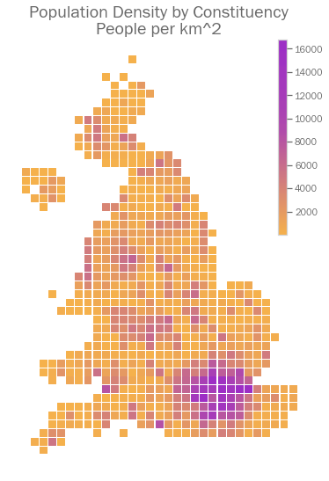
Population and population density by constituency
Additional Analysis

Slide 17
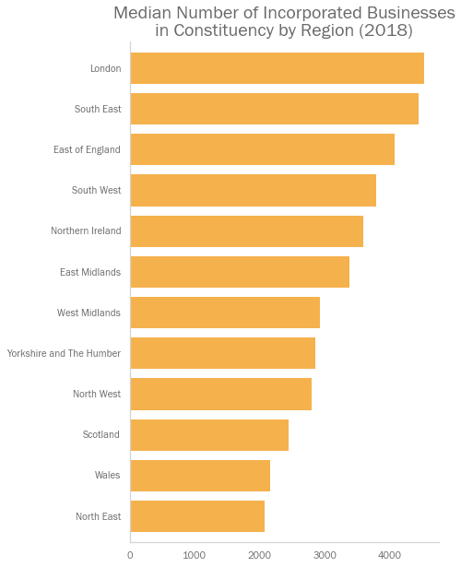
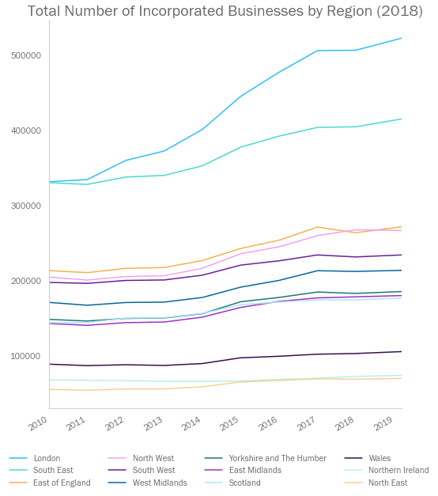
Incorporated businesses by region
Additional Analysis

Slide 18
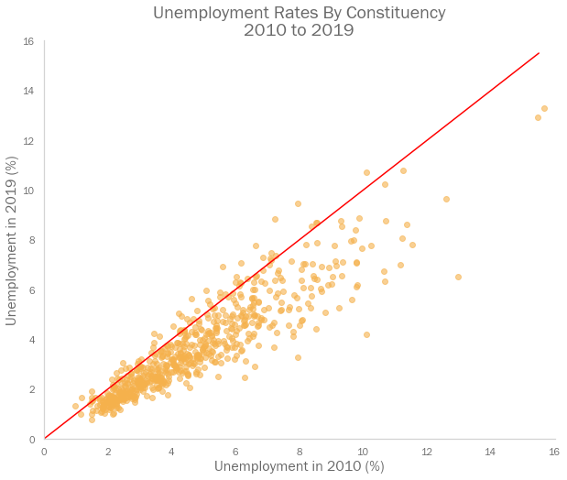
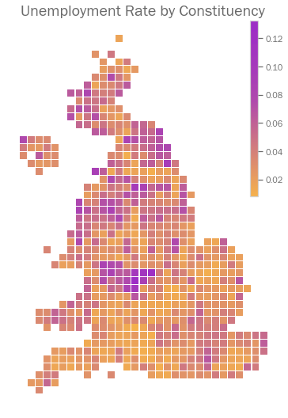
Unemployment
Additional Analysis

Slide 19
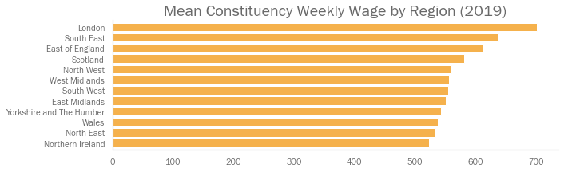
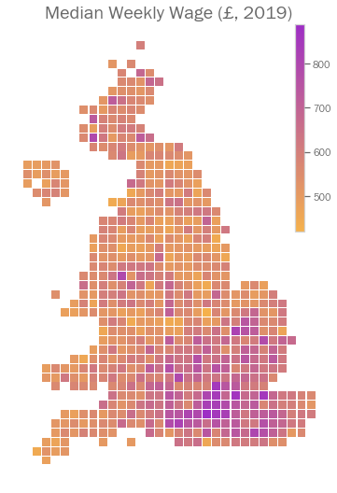
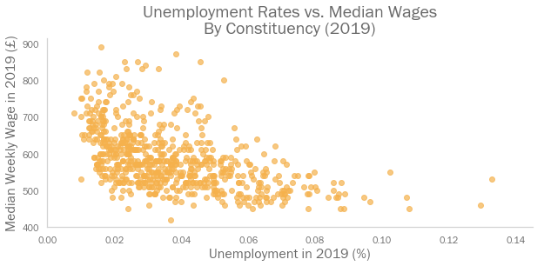
Wages
Additional Analysis

Slide 20
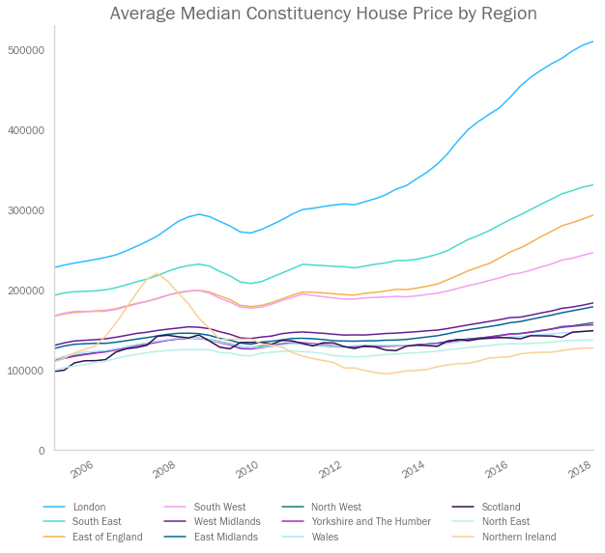
House prices
Additional Analysis

Slide 21
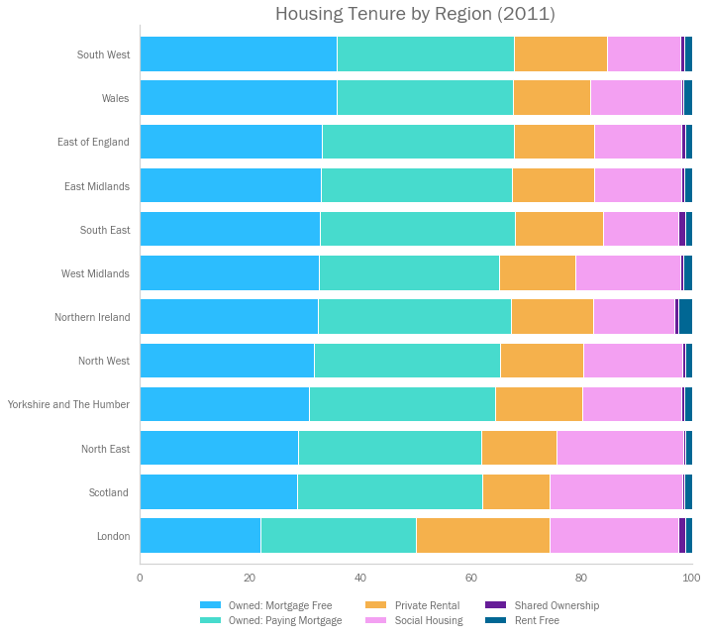
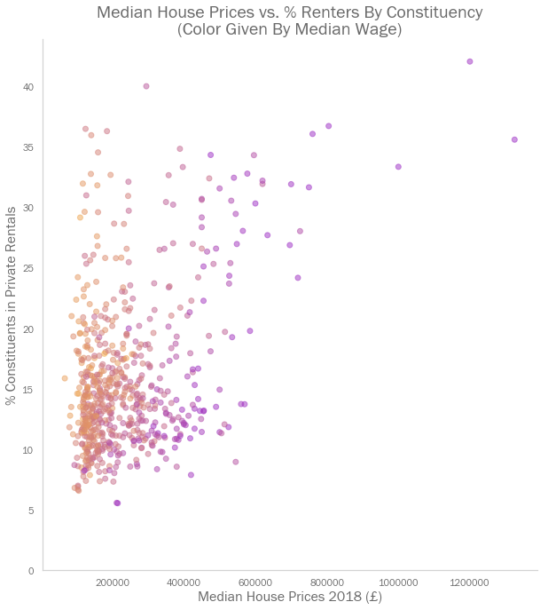
Housing tenure
Additional Analysis

Slide 22
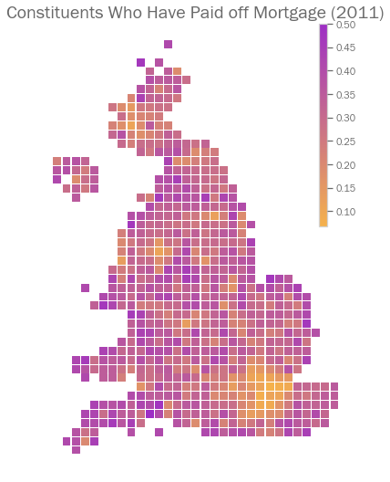
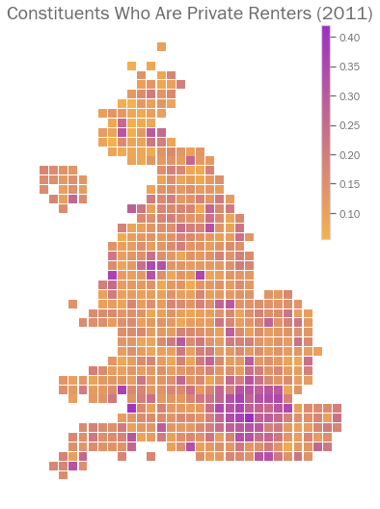
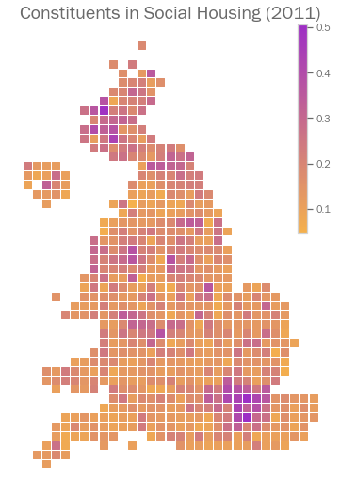
House ownership
Additional Analysis

Slide 23
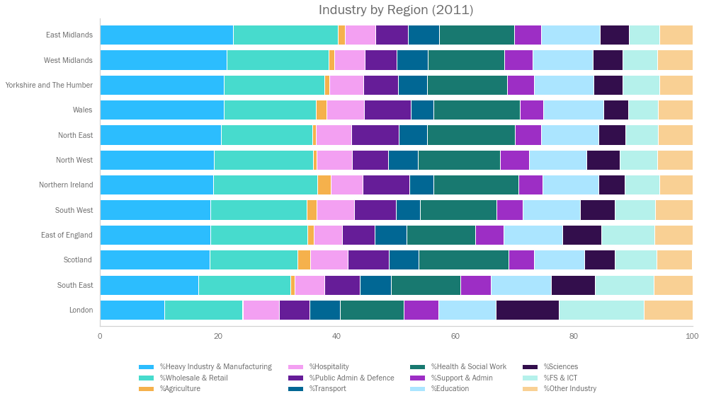
Industry
Additional Analysis

Slide 24
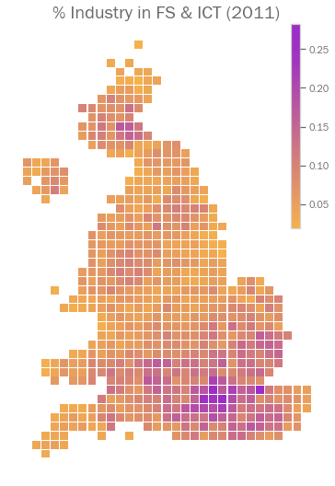
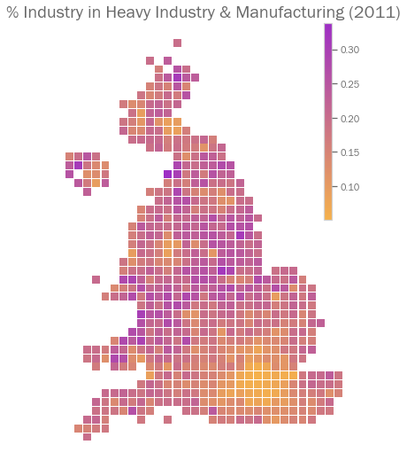
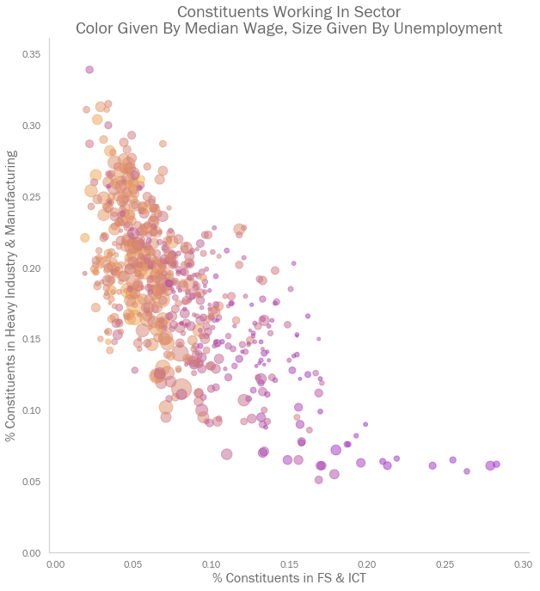
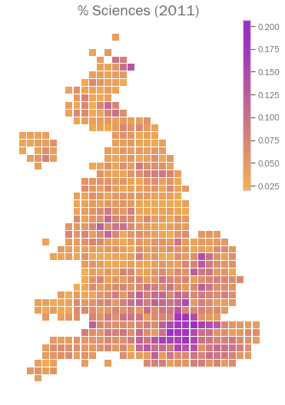
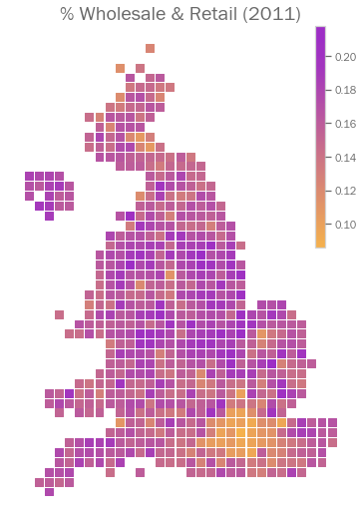
Employment by industry
Additional Analysis

Slide 25
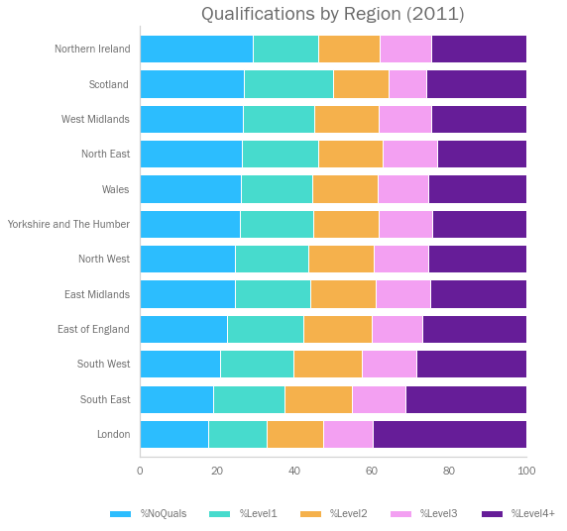
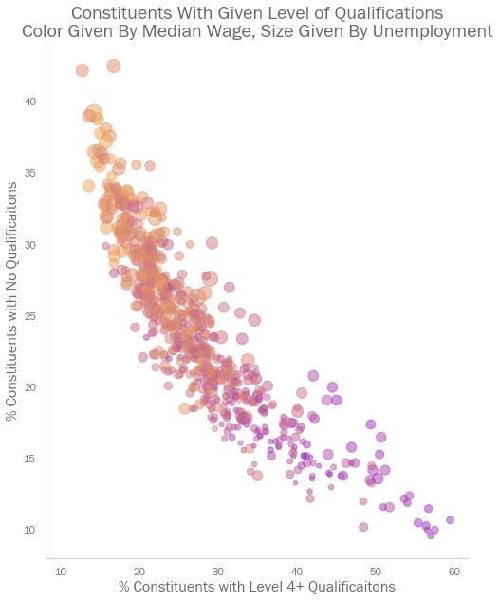
Qualification levels
Additional Analysis

Slide 26
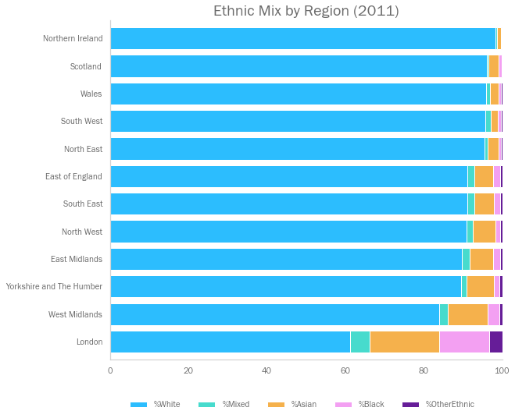
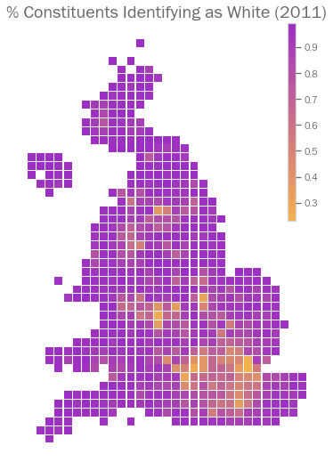
Ethnicity
Additional Analysis

Slide 27
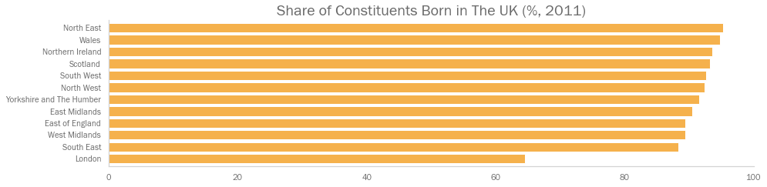
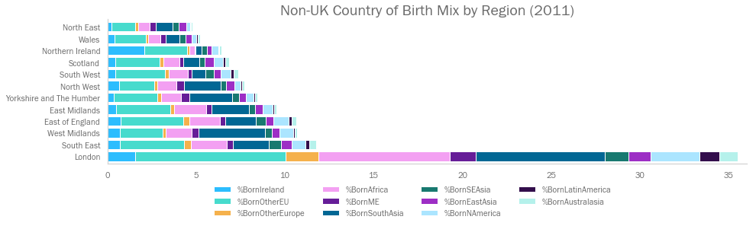
Country of birth by region
Additional Analysis

Slide 28
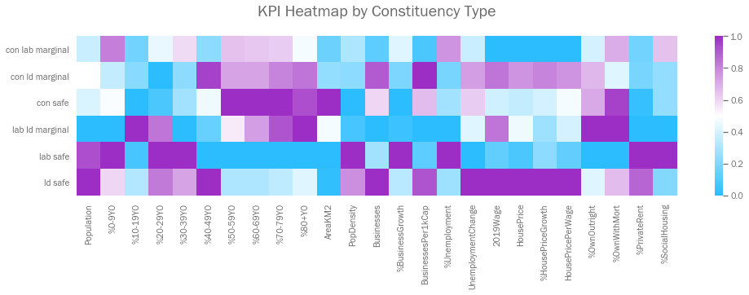
English seat type comparison (1/4)
Analysis considers the mean value for constituencies in each category, then normalises these means on a 0-1 scale to see how the different voter tribes compare.
Younger constituencies tend to vote Labour and Liberal Democrat, whereas older voters tend Conservative.
Lib Dems were consistently strongest in areas with high wages, and high house prices.
Labour were especially strong in areas with high levels of renting and social housing.

Slide 29
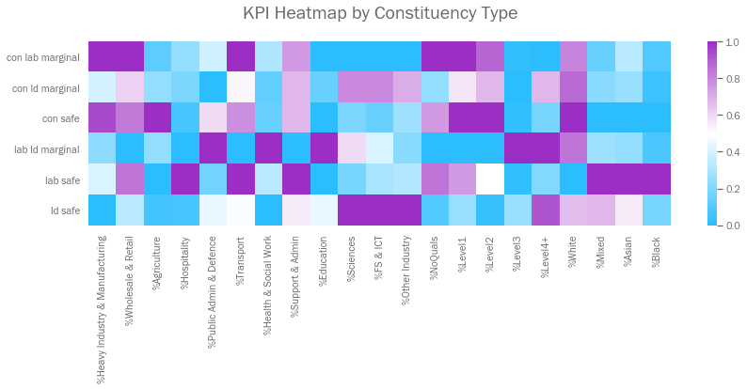
English seat type comparison (2/4)
Analysis considers the mean value for constituencies in each category, then normalises these means on a 0-1 scale to see how the different voter tribes compare.
Different parties appeal to workers in different industries. Labour appeals to the lower-skilled service industries, Conservatives to heavy industry, and Lib Dems to high-powered white-collar work.
Labour (and the Lib Dems to a lesser extent) did better in areas with high ethnic diversity.

Slide 30
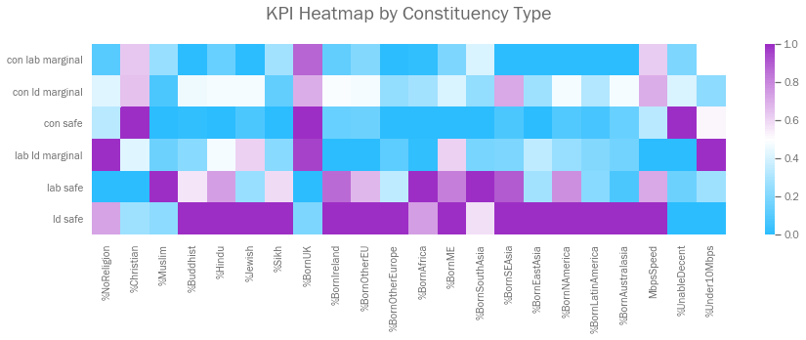
English seat type comparison (3/4)
Analysis considers the mean value for constituencies in each category, then normalises these means on a 0-1 scale to see how the different voter tribes compare.
Conservatives strong in areas with high levels of self-declared Christians (typically older, whiter voters)
Lib Dems and Labour strong in areas with high levels of religious and ethnic diversity (Conservatives the opposite)
Conservatives very strong in places unable to get good broadband connections...

Slide 31
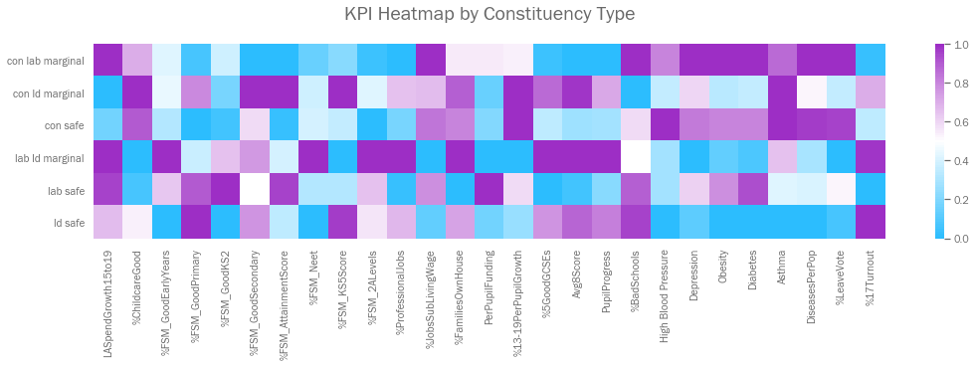
English seat type comparison (4/4)
Analysis considers the mean value for constituencies in each category, then normalises these means on a 0-1 scale to see how the different voter tribes compare.
Conservatives stronger in places with higher rates of chronic diseases. Again, this is likely to be due to older voters.
Competitive Lib Dem seats tend to have high levels of political engagement.

